Slide 1
DBA: Dynamic Bandit Algorithm
Sadegh Nobari (Sasha)
Intelligence domain
RIT Department
(0) Short Bio (1)Problem (2)FBA vs. DBA (3)DBA (4)Exp. (5)Theory

Slide 2

Senior Data Scientist
PhD in Computer Science from NUS
National University of Singapore
More than 8 years of experience in the field of Data management
EPFL, Switzerland
Singapore Management University, Singapore
Skoltech, Russia
Innopolis, Russia
Winner of SMU innovation award 2013 and NUS startup weekend 2012
(0) Short Bio (1)Problem (2)FBA vs. DBA (3)Exp. (4)DBA (5)Theory

Slide 3





Problem
1) We have multiple candidates (like layouts for our ichiba webpage)
2) Many users are browsing our webpage
How to select from these candidates?
N.B. the candidates can also be selecting subset of items based on a criteria (e.g. KPI)
OR selecting between multiple recommendation algorithms!
Which layout/
candidate to select?
(1)Problem (2)FBA vs. DBA (3)Exp. (4)DBA (5)Theory

Slide 4

FBA: Fixed Bandit Algorithm (Traditional)
Assumes each candidate has a FIXED (CONSTANT) performance over the whole period of time.
Given this critical assumption (fixed performance) we are aiming to minimize the regret in order to maximize the overall performance.
(1)Problem (2)FBA vs. DBA (3)Exp. (4)DBA (5)Theory

Slide 5
DBA: Dynamic Bandit Algorithm (Our solution)
Assumes each candidate has a Dynamic performance, i.e. a changing behavior over the time.
(1)Problem (2)FBA vs. DBA (3)Exp. (4)DBA (5)Theory

Slide 6
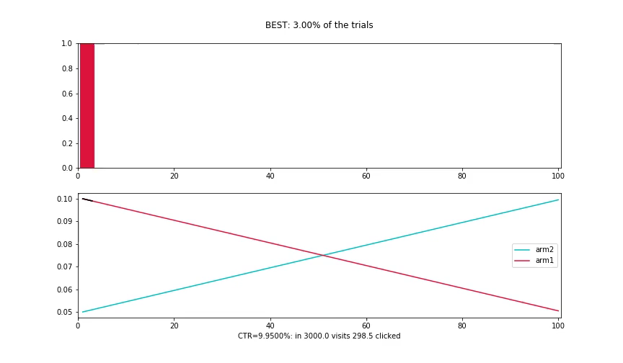
Best case scenario (Upper Bound)
Assumes we know the future’s feedback in advance!
(1)Problem (2)FBA vs. DBA (3)Exp. (4)DBA (5)Theory

Slide 7
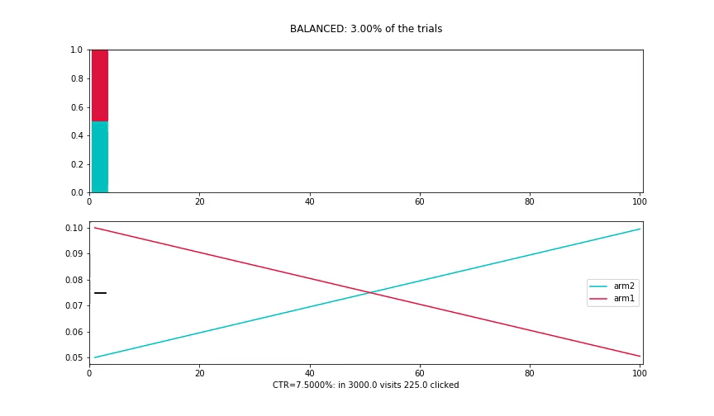
A/B Testing
Constant ratio for every candidate!
(1)Problem (2)FBA vs. DBA (3)Exp. (4)DBA (5)Theory

Slide 8
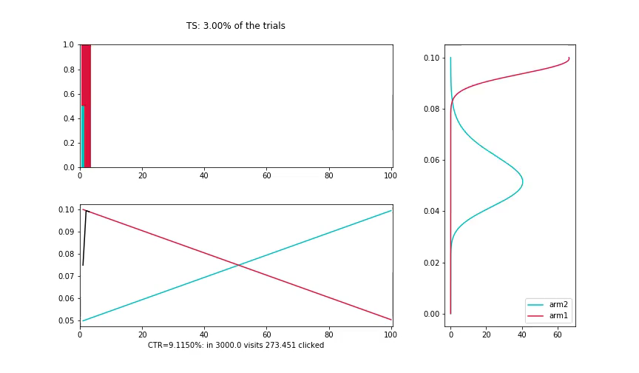
FBA: Fixed Bandit Algorithm (Traditional)
Assumes each candidate has a FIXED (CONSTANT) performance over the whole period of time.
(1)Problem (2)FBA vs. DBA (3)Exp. (4)DBA (5)Theory

Slide 9
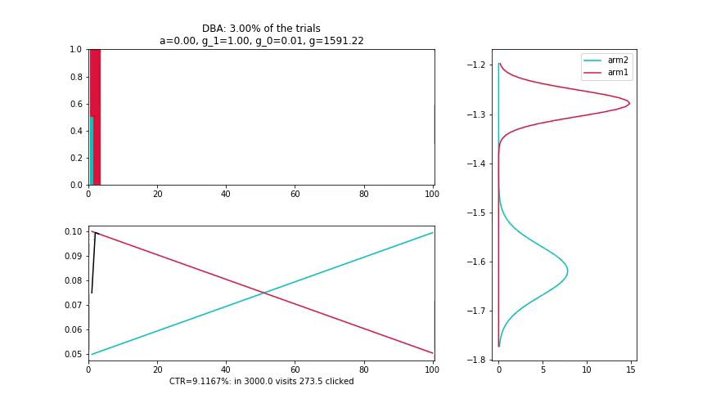
DBA: Dynamic Bandit Algorithm
Assumes each candidate has a Dynamic performance, i.e. a changing behavior over the time.
(1)Problem (2)FBA vs. DBA (3)Exp. (4)DBA (5)Theory

Slide 10

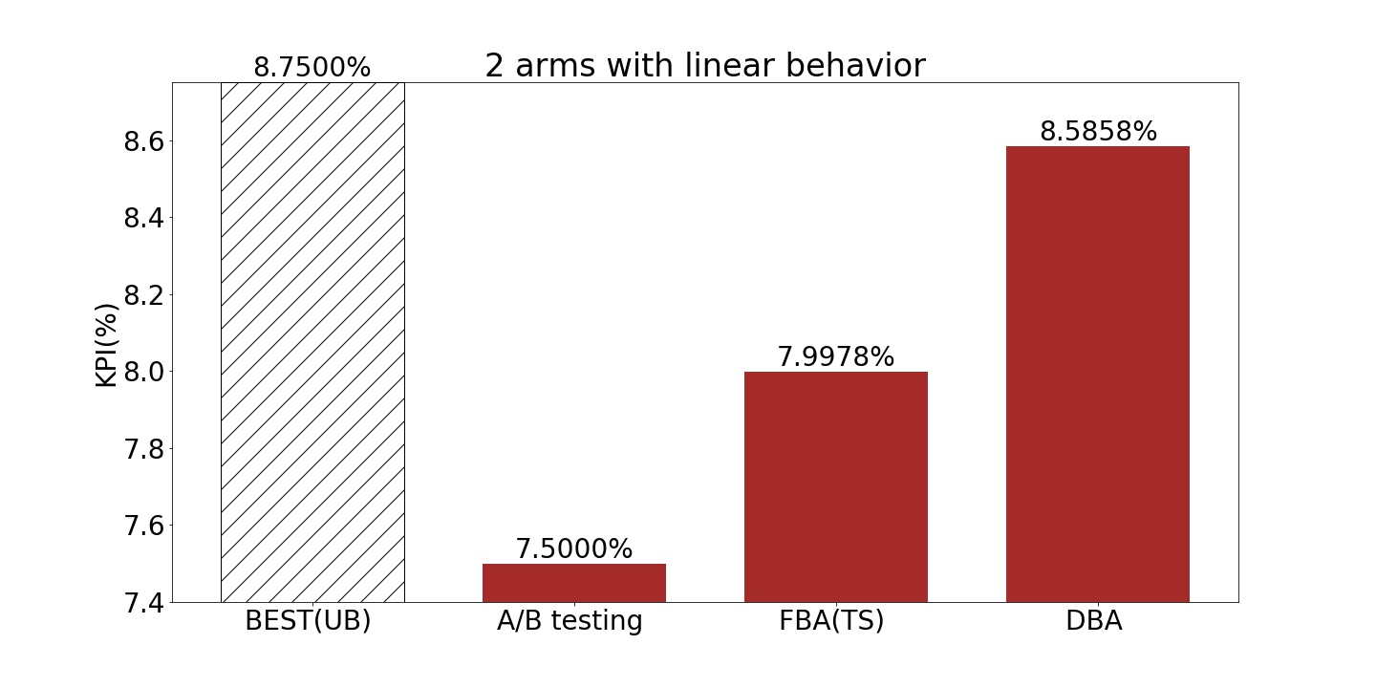
Comparison
(1)Problem (2)FBA vs. DBA (3)Exp. (4)DBA (5)Theory

Slide 11
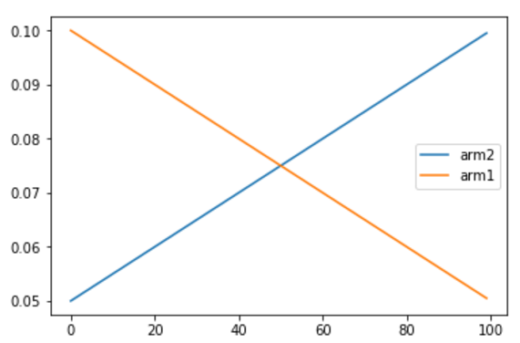
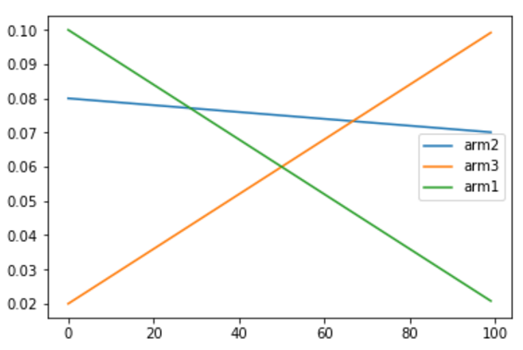
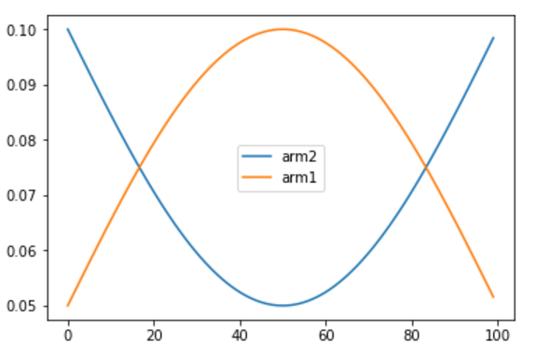
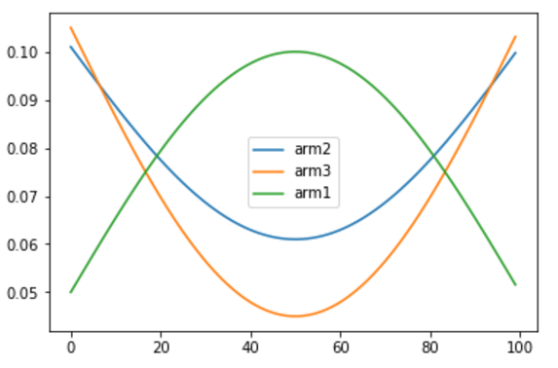
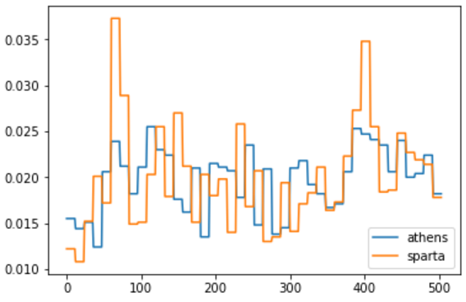
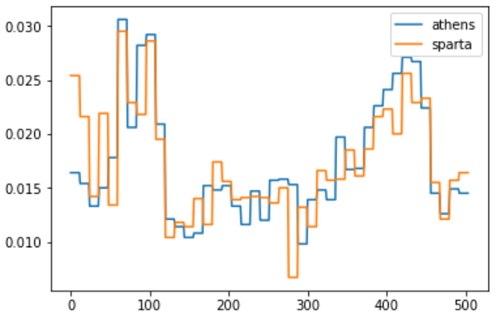
DBA: Dynamic Bandit Algorithm- Experiment
Assumes each candidate has a Dynamic performance, i.e. a changing behavior over the time, hence for each item:
2 sets of exp.:
Simulation:
2 and 3 arms with various dist. of performance
Real data:
6 weeks CVR and CTR of two recommendation algorithms
Rakuten Travel data
(1)Problem (2)FBA vs. DBA (3)Exp. (4)DBA (5)Theory

Slide 12

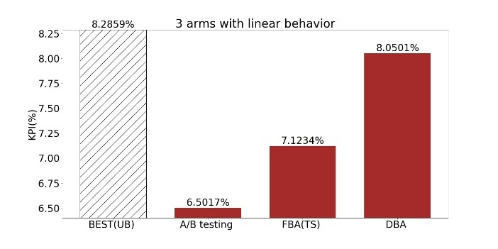
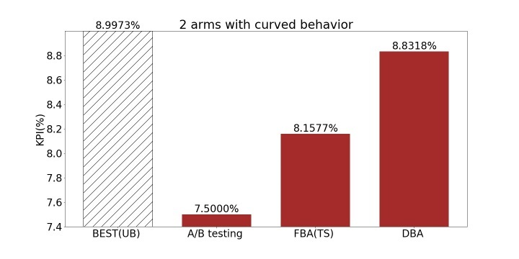
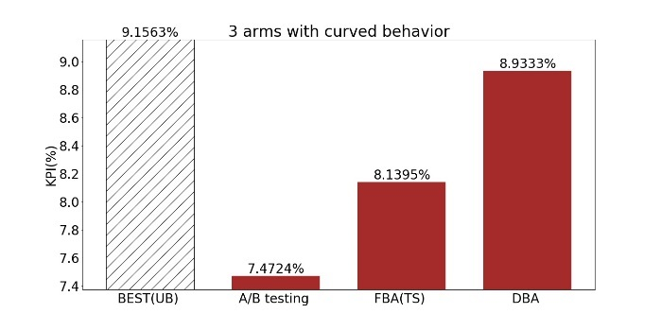
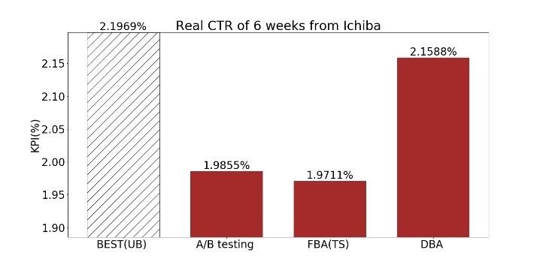
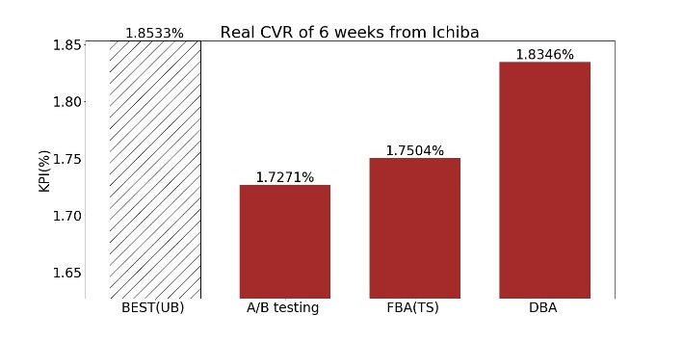
DBA: Dynamic Bandit Algorithm- Experiment
http://bit.ly/sashaDBA
http://bit.ly/DBAtravel
(1)Problem (2)FBA vs. DBA (3)Exp. (4)DBA (5)Theory

Slide 13
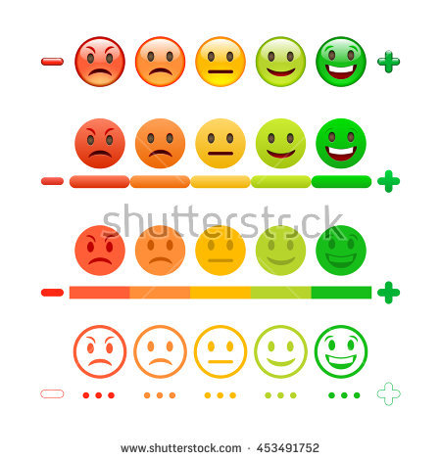
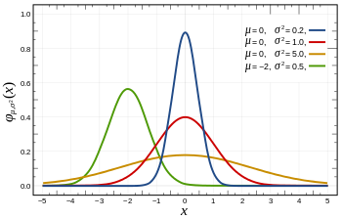
DBA: Dynamic Bandit Algorithm
Assumes each candidate has a Dynamic performance, i.e. a changing behavior over the time, hence for each item:
Given the observations DBA applies:
A prior normal distribution
With a changing mean that follows another normal distribution
Reminiscent of Wiener process (a.k.a. standard Brownian motion process or Lévy processes):
Gaussian increments between the CTR i and i+j
With future Independent increments of the CTRs:
CTR_{i+j} – CTR_{i} is independent to CTR_{k} for k<i
(1)Problem (2)FBA vs. DBA (3)Exp. (4)DBA (5)Theory

Slide 14
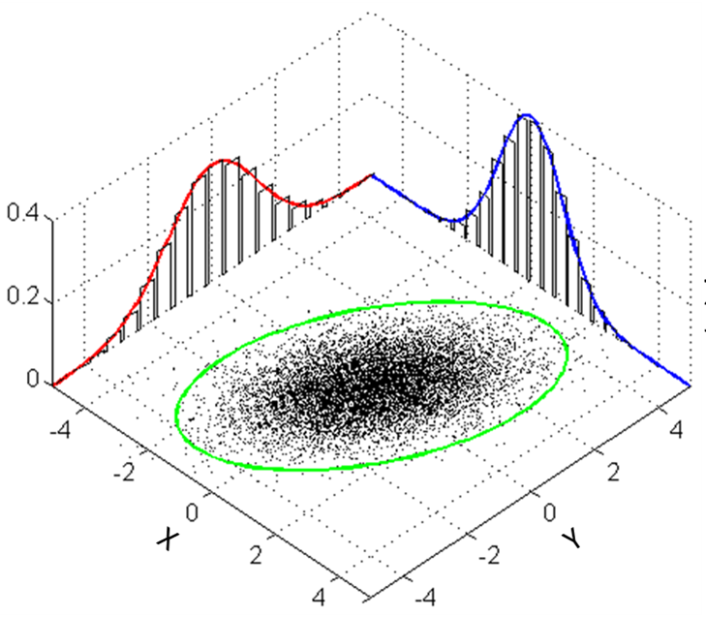




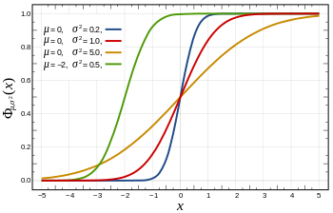














DBA: Dynamic Bandit Algorithm
Assumes each candidate has a Dynamic performance, i.e. a changing behavior over the time, assuming for each item:
α
α
α
$τ$₀
$τ$₀
$τ$₀
$$τ$$
$$τ$$
X_{i-1}
X_{i}
X_{i+1}
$${\overline{τ}}_{i−1}$$
$${\overline{τ}}_{i}$$
$${\overline{τ}}_{i+1}$$
$\overline{z}$_{i-1}
$\overline{z}$_{i}
$\overline{z}$_{i+1}
$z$₁ … $z$_{n(i-1)}
$z$₁ … $z$_{n(i)}
$z$₁ … $z$_{n(i+1)}
(1)Problem (2)FBA vs. DBA (3)Exp. (4)DBA (5)Theory

Slide 15
DBA: Dynamic Bandit Algorithm
Assumes each candidate has a Dynamic performance, i.e. a changing behavior over the time.
In order to draw the multivariate normal distribution of each item, our solution consists of 4 steps:
Generative Model
Applying prior
Applying observations
Marginalization
Finally, calculating the proportion of selection of each item for a given traffic [thanks to PPF and CDF of normal dist.].
(1)Problem (2)FBA vs. DBA (3)Exp. (4)DBA (5)Theory

Slide 16


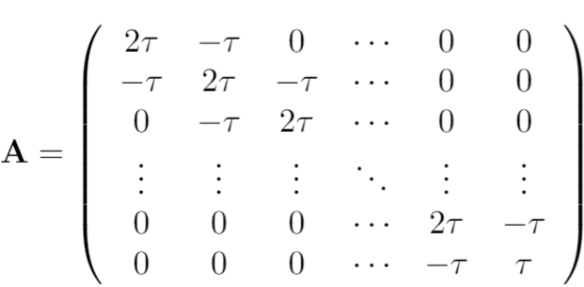




DBA: Dynamic Bandit Algorithm-Generative Model
Assumes each candidate has a Dynamic performance, i.e. a changing behavior over the time, hence for each item:
α
α
α
$τ$₀
$τ$₀
$τ$₀
$$τ$$
$$τ$$
X_{i-1}
X_{i}
X_{i+1}
$${\overline{τ}}_{i−1}$$
$${\overline{τ}}_{i}$$
$${\overline{τ}}_{i+1}$$
$\overline{z}$_{i-1}
$\overline{z}$_{i}
$\overline{z}$_{i+1}
$z$₁ … $z$_{n(i-1)}
$z$₁ … $z$_{n(i)}
$z$₁ … $z$_{n(i+1)}
(1)Problem (2)FBA vs. DBA (3)Exp. (4)DBA (5)Theory

Slide 17
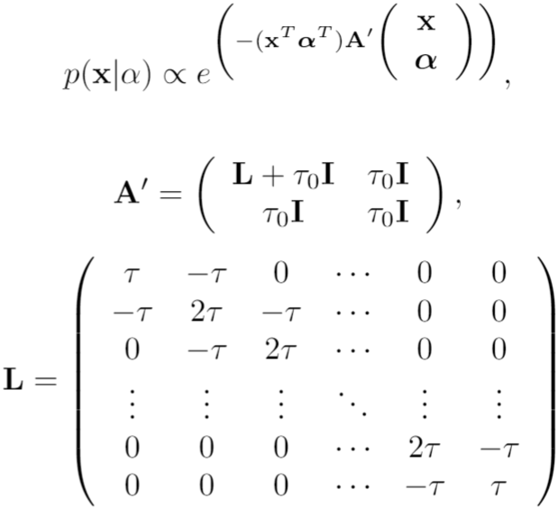
DBA: Dynamic Bandit Algorithm-Applying prior
Assumes each candidate has a Dynamic performance, i.e. a changing behavior over the time, hence for each item:
α
α
α
$τ$₀
$τ$₀
$τ$₀
$$τ$$
$$τ$$
X_{i-1}
X_{i}
X_{i+1}
$${\overline{τ}}_{i−1}$$
$${\overline{τ}}_{i}$$
$${\overline{τ}}_{i+1}$$
$\overline{z}$_{i-1}
$\overline{z}$_{i}
$\overline{z}$_{i+1}
$z$₁ … $z$_{n(i-1)}
$z$₁ … $z$_{n(i)}
$z$₁ … $z$_{n(i+1)}
(1)Problem (2)FBA vs. DBA (3)Exp. (4)DBA (5)Theory

Slide 18
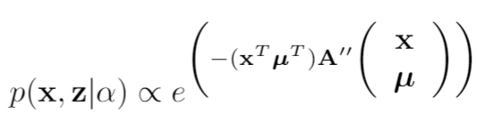

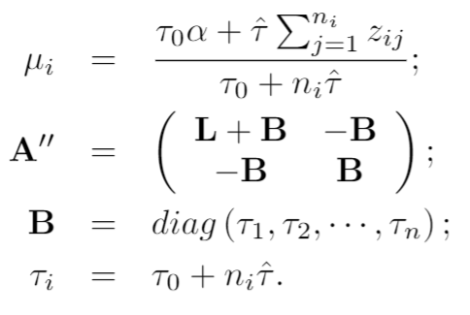
DBA: Dynamic Bandit Algorithm-Apply observations
Assumes each candidate has a Dynamic performance, i.e. a changing behavior over the time, hence for each item:
α
α
α
$τ$₀
$τ$₀
$τ$₀
$$τ$$
$$τ$$
X_{i-1}
X_{i}
X_{i+1}
$${\overline{τ}}_{i−1}$$
$${\overline{τ}}_{i}$$
$${\overline{τ}}_{i+1}$$
$\overline{z}$_{i-1}
$\overline{z}$_{i}
$\overline{z}$_{i+1}
$z$₁ … $z$_{n(i-1)}
$z$₁ … $z$_{n(i)}
$z$₁ … $z$_{n(i+1)}
(1)Problem (2)FBA vs. DBA (3)Exp. (4)DBA (5)Theory

Slide 19
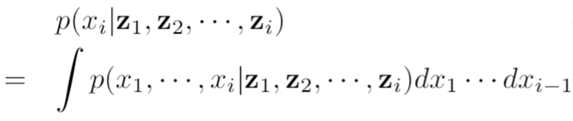
DBA: Dynamic Bandit Algorithm- Marginalization
Assumes each candidate has a Dynamic performance, i.e. a changing behavior over the time, hence for each item:
α
α
α
$τ$₀
$τ$₀
$τ$₀
$$τ$$
$$τ$$
X_{i-1}
X_{i}
X_{i+1}
$${\overline{τ}}_{i−1}$$
$${\overline{τ}}_{i}$$
$${\overline{τ}}_{i+1}$$
$\overline{z}$_{i-1}
$\overline{z}$_{i}
$\overline{z}$_{i+1}
$z$₁ … $z$_{n(i-1)}
$z$₁ … $z$_{n(i)}
$z$₁ … $z$_{n(i+1)}
(1)Problem (2)FBA vs. DBA (3)Exp. (4)DBA (5)Theory

Slide 20
Proportion
We can obtain feedback from and accordingly forming decision for
1) a single user at a time
2) a batch of users at a time
These types of feedback ask for different granularity of our decision making for each point in time.
Which one to select for a single user?
(item)
Calculating proportion
Or
traffic
(%)
(1)Problem (2)FBA vs. DBA (3)Exp. (4)DBA (5)Theory

